Slide 1
EARTHQUAKES

Slide 2
What is an Earthquake?
An earthquake is what happens when two blocks of the earth suddenly slip past one another. The surface where they slip is called the fault or fault plane.
The location below the earth’s surface where the earthquake starts is called the hypocenter, and the location directly above it on the surface of the earth is called the epicenter.

Slide 3
Sometimes an earthquake has foreshocks. These are smaller earthquakes that happen in the same place as the larger earthquake that follows.
Scientists can’t tell that an earthquake is a foreshock until the larger earthquake happens. The largest, main earthquake is called the mainshock.

Slide 4
What causes earthquakes and where do they happen?
The crust and the top of the mantle make up a thin skin on the surface of our planet. But this skin is not all in one piece – it is made up of many pieces like a puzzle covering the surface of the earth.
These puzzle pieces keep slowly moving around, sliding past one another and bumping into each other.
We call these puzzle pieces tectonic plates, and the edges of the plates are called the plate boundaries.

Slide 5
The plate boundaries are made up of many faults, and most of the earthquakes around the world occur on these faults.
Since the edges of the plates are rough, they get stuck while the rest of the plate keeps moving. Finally, when the plate has moved far enough, the edges unstick on one of the faults and there is an earthquake.

Slide 6
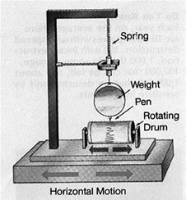
How are earthquakes recorded?
Earthquakes are recorded by instruments called seismographs. The recording they make is called a seismogram.
The seismograph has a base
that sets firmly in the ground,
and a heavy weight that
hangs free. When an
earthquake causes the ground
to shake, the base of the
seismograph shakes too,
but the hanging weight
does not.

Slide 7
How do scientists measure the size of earthquakes?
The size of an earthquake depends on the size of the fault and the amount of slip on the fault, but that’s not something scientists can simply measure with a measuring tape since faults are many kilometers deep beneath the earth’s surface.
They use the seismogram recordings made on the seismographs at the surface of the earth to determine how large the earthquake is/was

Slide 8
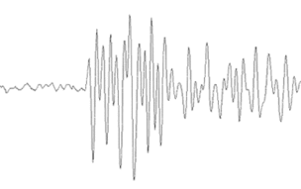
A short wiggly line that doesn’t wiggle very much means a small earthquake, and a long wiggly line that wiggles a lot means a large earthquake.
The length of the wiggle depends on the size of the fault, and the size of the wiggle depends on the amount of slip.

Slide 9
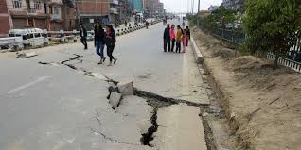
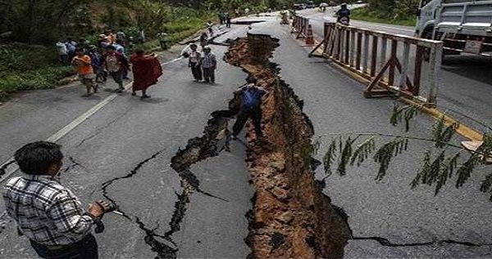
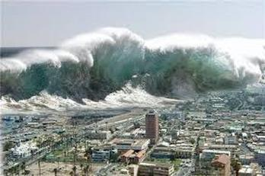
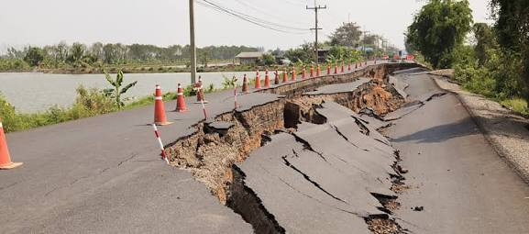
The Following Images shows the effects of earthquakes

